Slide 2
Thesis Presentation
Prince Frederick Hall, University of Maryland
Completed by: Lauren Kandt
PSU AE, Construction Management
Advisor: Ray Sowers
April 2014

Slide 3
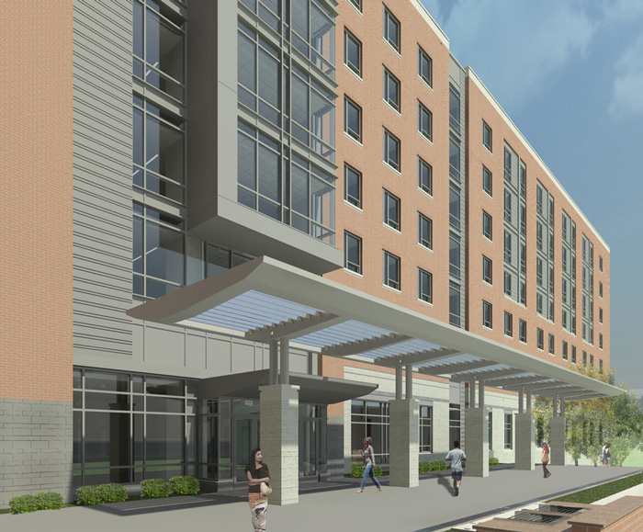
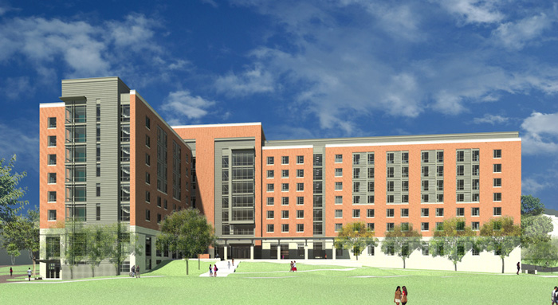
Introduction
Building Information
Infinity System Investigation
Grey Water System Investigation
Photovoltaic Cell Window Investigation
  Architectural Breadth
Information Transfer Research
  Survey Results
  App Business Plan
Recommendation
Notes:
Images taken from:
http://www.reslife.umd.edu/princefrederick/renderings/

Slide 4
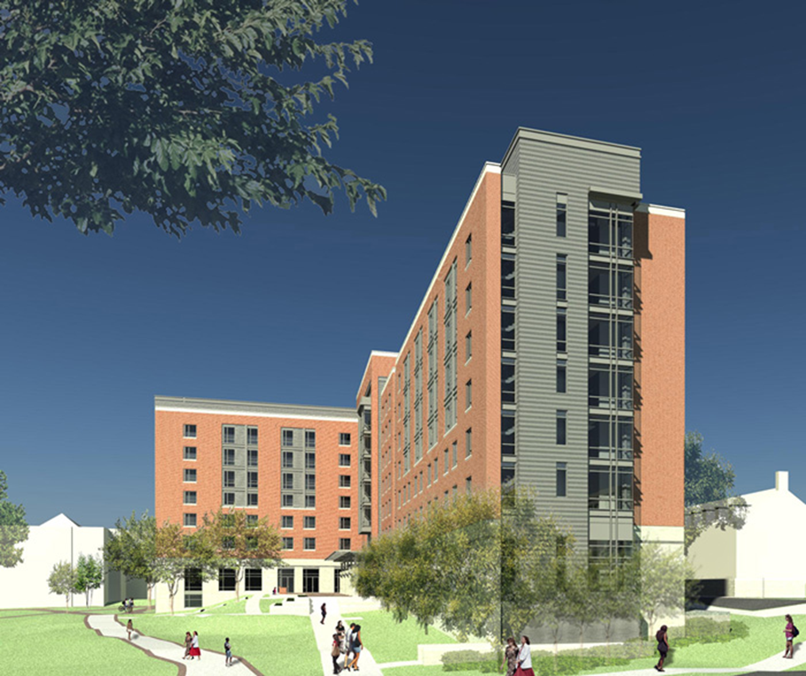


Building Information
Introduction
  Building Information
Infinity System Investigation
Grey Water System Investigation
Photovoltaic Cell Window Investigation
  Architectural Breadth
Information Transfer Research
  Survey Results
  App Business Plan
Recommendation
Notes:
Images taken from:
http://www.reslife.umd.edu/princefrederick/renderings/
http://www.greentribune.com/leed-exam-preparation/

Slide 5
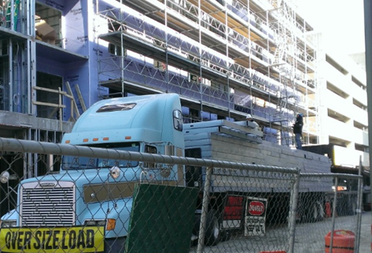
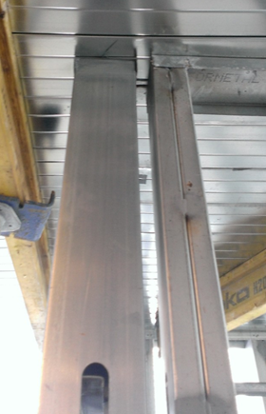
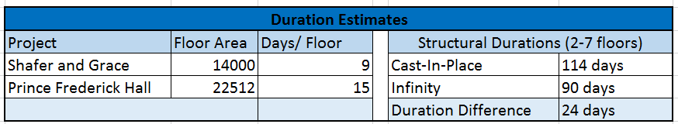
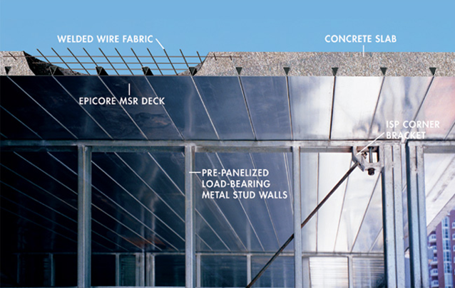
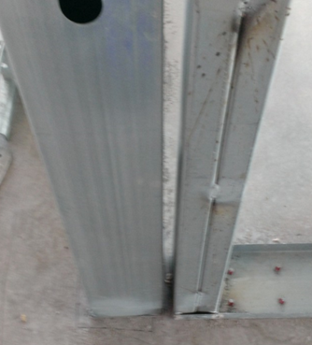

Infinity Structural System Investigation
Introduction
  Building Information
Infinity System Investigation
Grey Water System Investigation
Photovoltaic Cell Window Investigation
  Architectural Breadth
Information Transfer Research
  Survey Results
  App Business Plan
Recommendation
Notes:
Images taken from:
Shafer and Grace site (taken by self)
Created by self
http://www.bisnow.com/events/dc/2011/montgomery-summit/index.htm

Slide 6
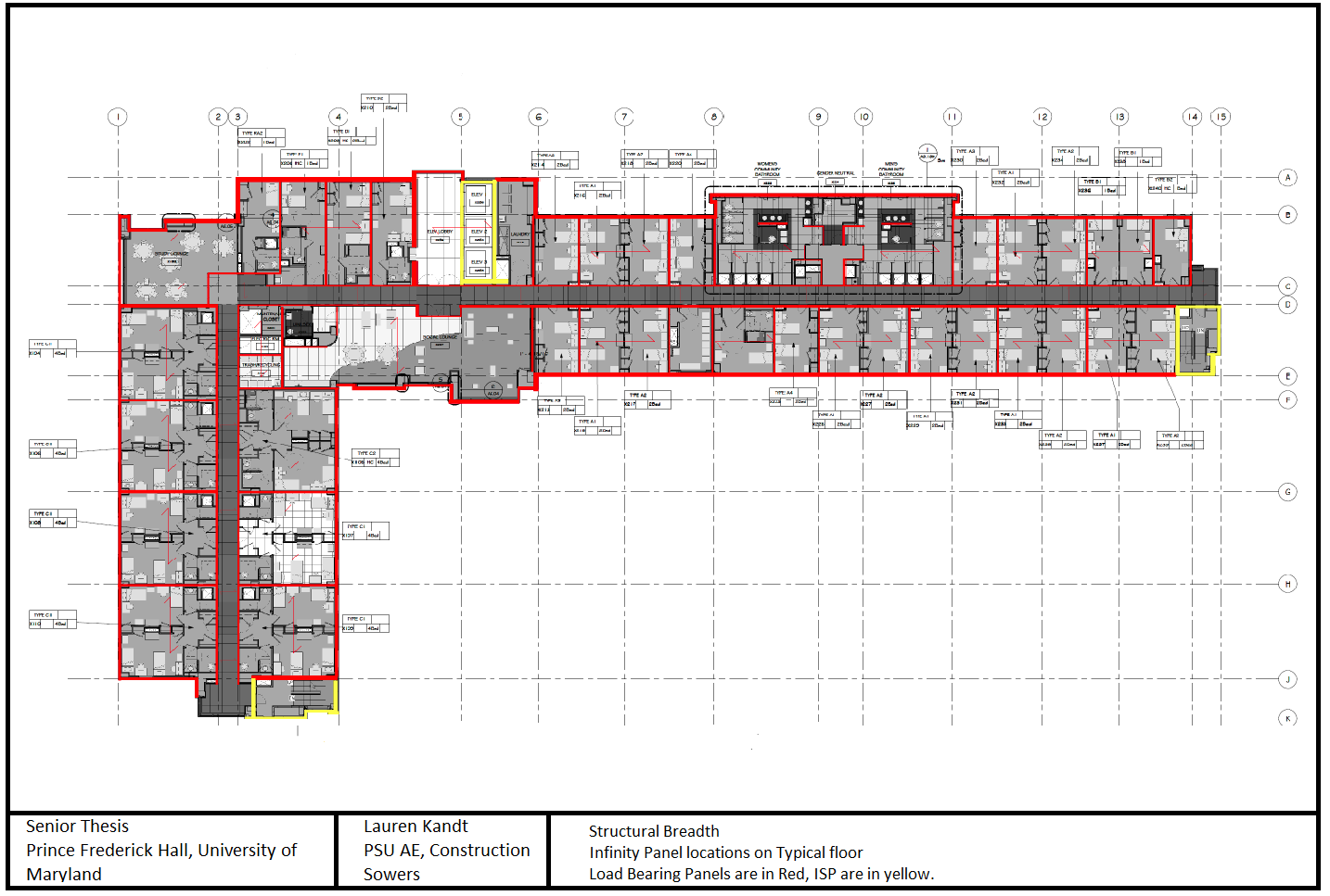
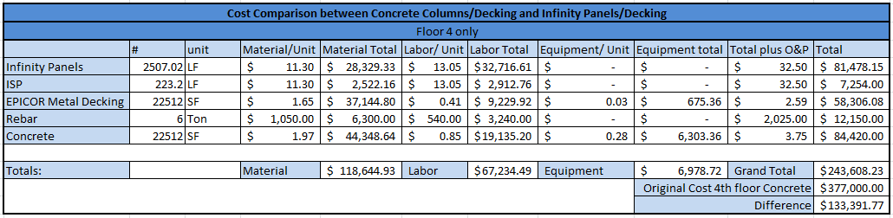
Infinity Structural System Investigation
Introduction
  Building Information
Infinity System Investigation
Grey Water System Investigation
Photovoltaic Cell Window Investigation
  Architectural Breadth
Information Transfer Research
  Survey Results
  App Business Plan
Recommendation
Notes:
Images taken from:
created by self

Slide 7
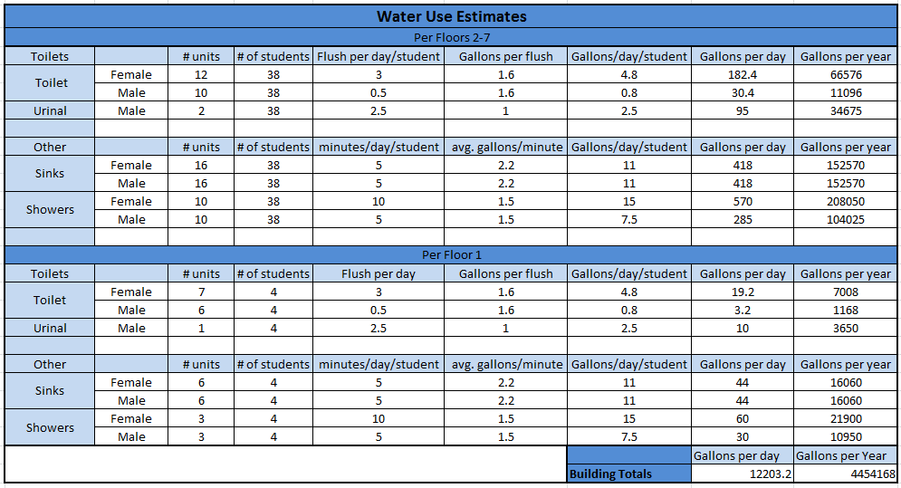
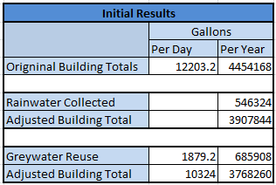
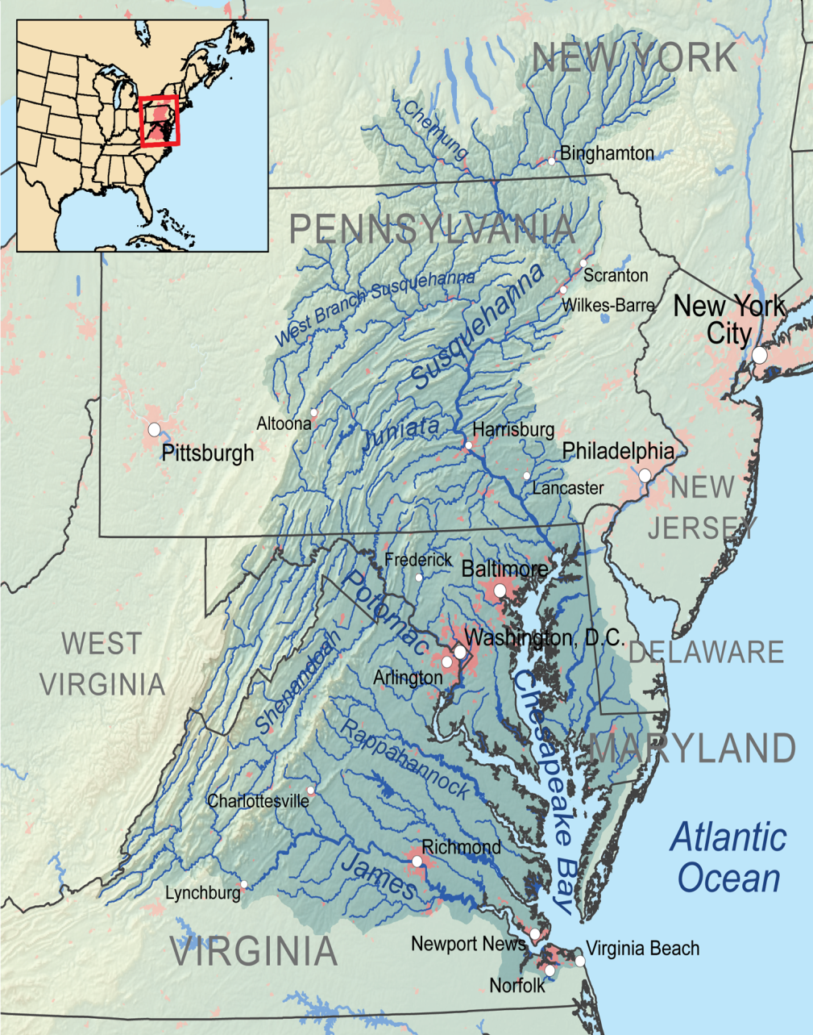
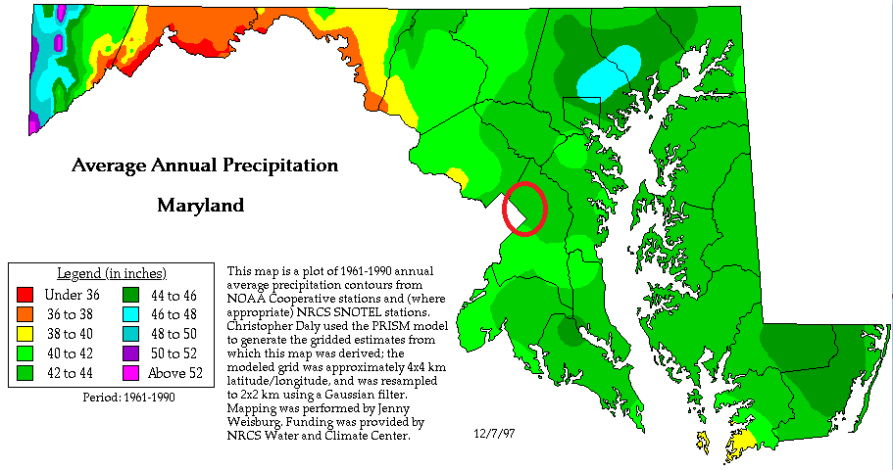
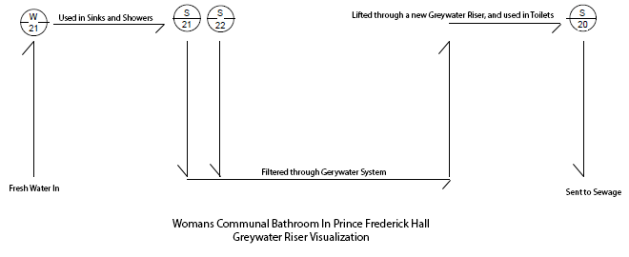
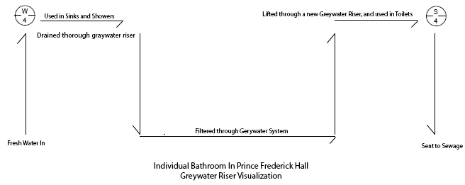
Grey Water System Investigation
Introduction
  Building Information
Infinity System Investigation
Grey Water System Investigation
Photovoltaic Cell Window Investigation
  Architectural Breadth
Information Transfer Research
  Survey Results
  App Business Plan
Recommendation
Notes:
Images taken by:
created by self
http://alldownstream.wordpress.com/category/agriculture/
US National weather service

Slide 8
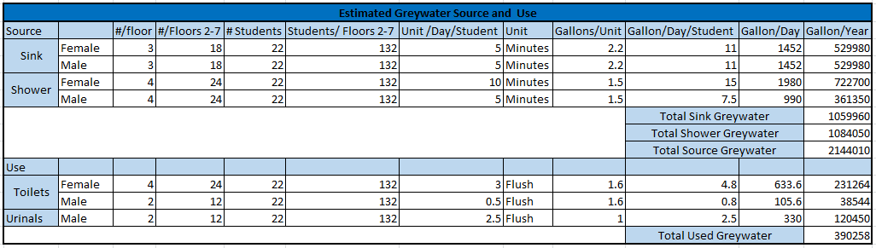
Grey Water System Investigation
Introduction
  Building Information
Infinity System Investigation
Grey Water System Investigation
Photovoltaic Cell Window Investigation
  Architectural Breadth
Information Transfer Research
  Survey Results
  App Business Plan
Recommendation
Notes:
Images taken from:
Created by self

Slide 9
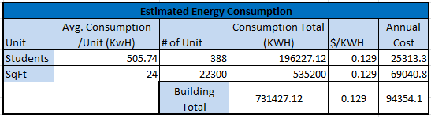
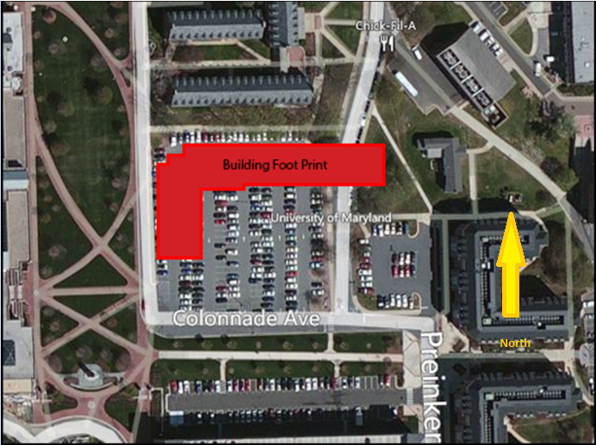
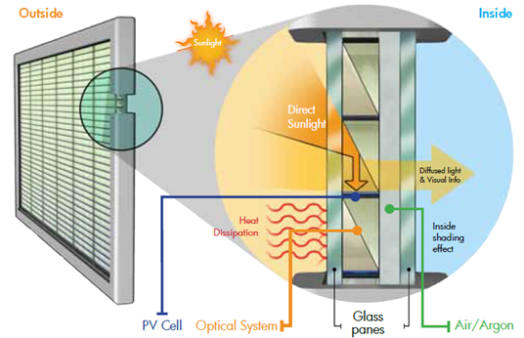
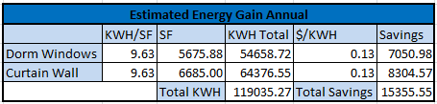
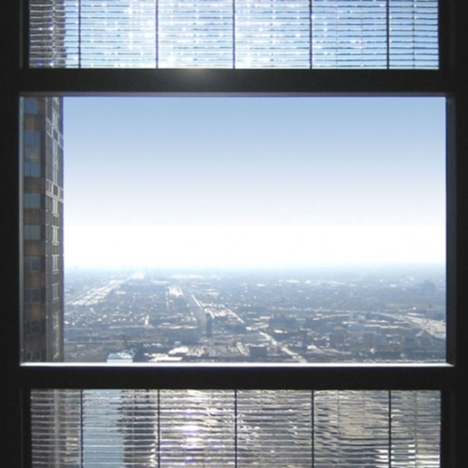

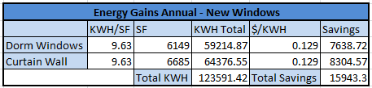
Photovoltaic Cell Window Investigation
Introduction
  Building Information
Infinity System Investigation
Grey Water System Investigation
Photovoltaic Cell Window Investigation
  Architectural Breadth
Information Transfer Research
  Survey Results
  App Business Plan
Recommendation
Notes:
Images taken from:
Created by self
http://www.triplepundit.com/2012/03/solar-paneled-windows-pythagoras-solar/
http://www.pythagoras-solar.com/

Slide 10
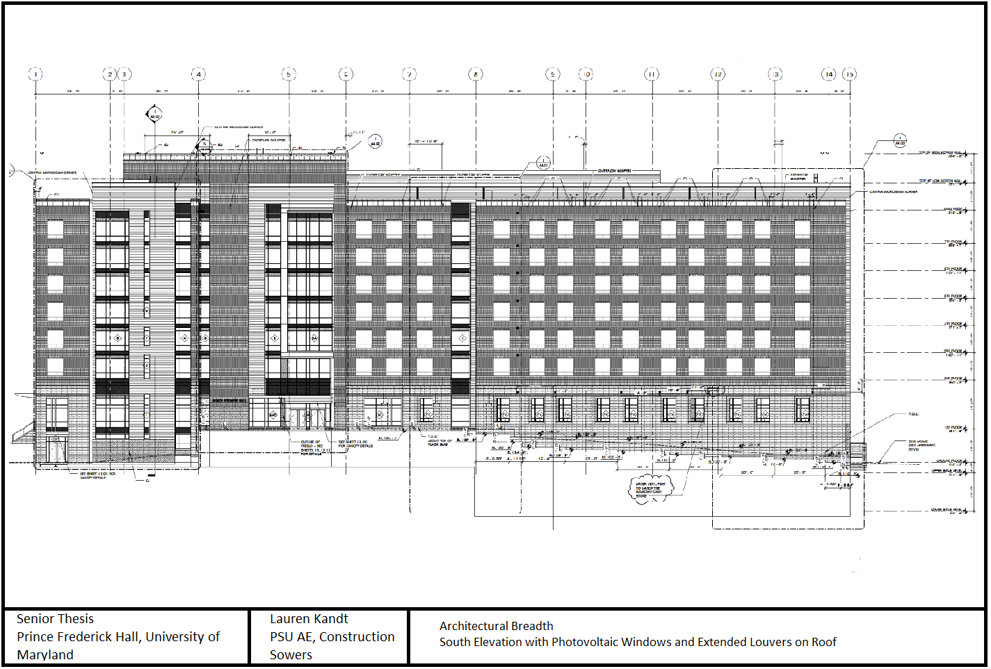
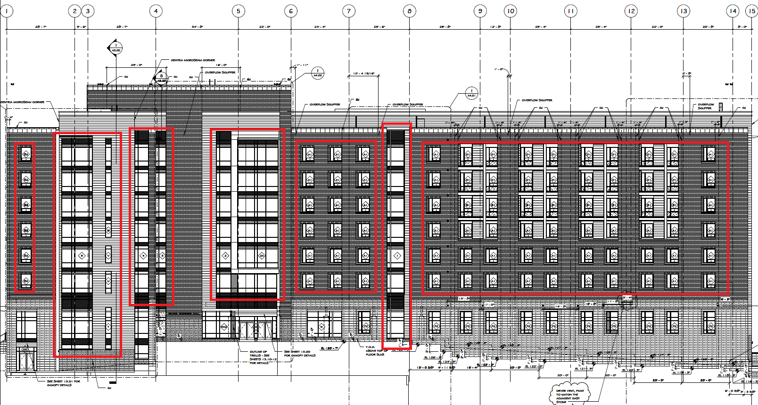
Photovoltaic Cell Window Investigation
Introduction
  Building Information
Infinity System Investigation
Grey Water System Investigation
Photovoltaic Cell Window Investigation
  Architectural Breadth
Information Transfer Research
  Survey Results
  App Business Plan
Recommendation
Notes:
Images taken from:
Created by self

Slide 11

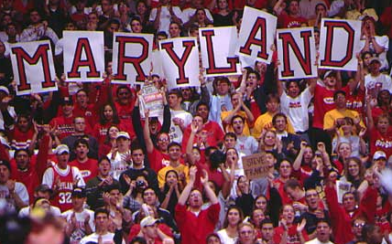
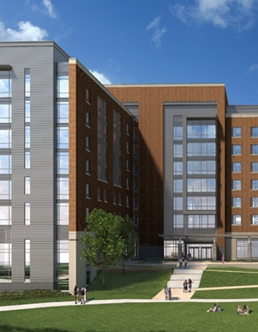


Information Transfer Investigation
Introduction
  Building Information
Infinity System Investigation
Grey Water System Investigation
Photovoltaic Cell Window Investigation
  Architectural Breadth
Information Transfer Research
  Survey Results
  App Business Plan
Recommendation
Notes:
Images taken from:
www.umd.edu
http://www.clarkconstruction.com/

Slide 12
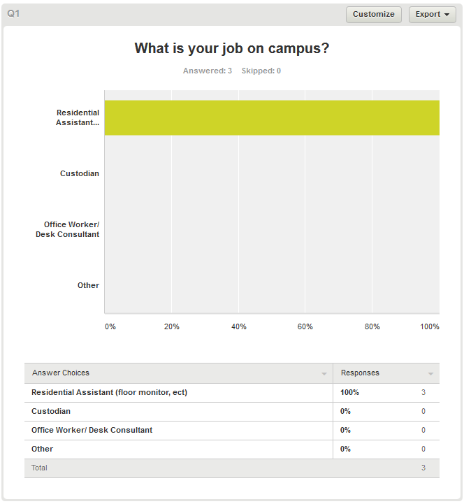
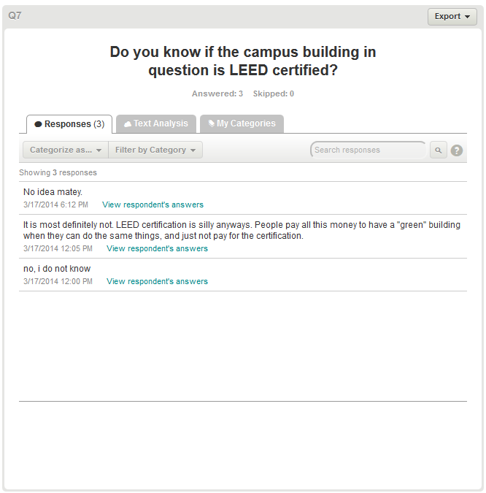
Information Transfer Investigation
Introduction
  Building Information
Infinity System Investigation
Grey Water System Investigation
Photovoltaic Cell Window Investigation
  Architectural Breadth
Information Transfer Research
  Survey Results
  App Business Plan
Recommendation
Notes:
Images taken from:
www.surveymonkey.com

Slide 13
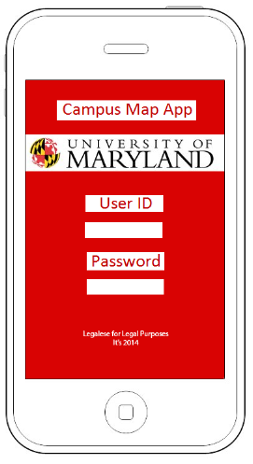
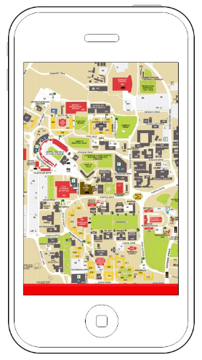
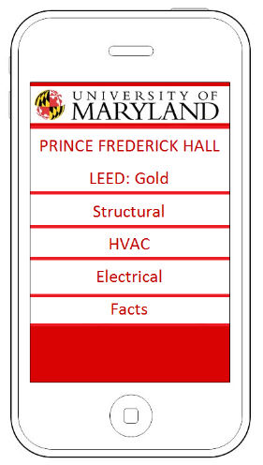
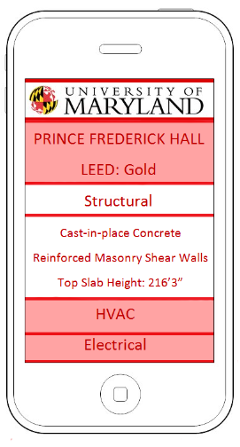
Information Transfer Research
Introduction
  Building Information
Infinity System Investigation
Grey Water System Investigation
Photovoltaic Cell Window Investigation
  Architectural Breadth
Information Transfer Research
  Survey Results
  App Business Plan
Recommendation
Notes:
Images taken from:
Created by self

Slide 14
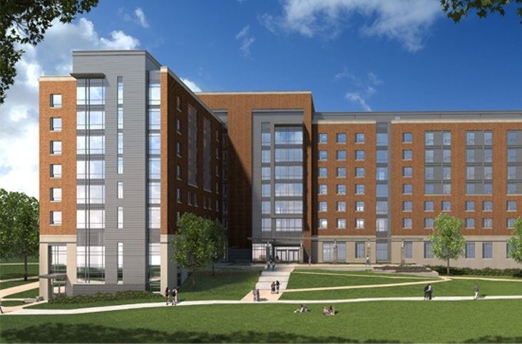
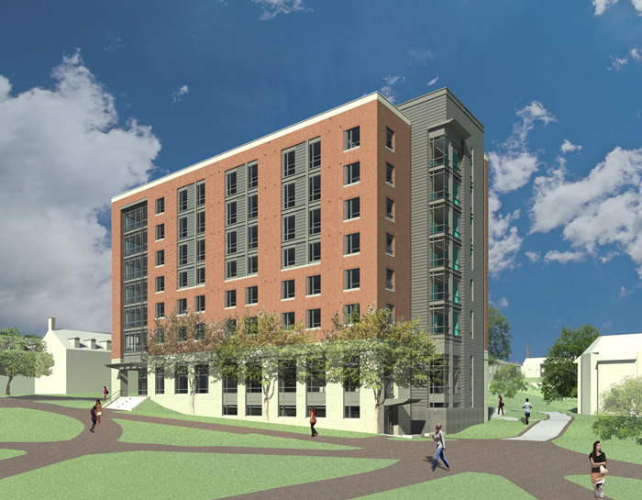
Recommendations
Introduction
  Building Information
Infinity System Investigation
Grey Water System Investigation
Photovoltaic Cell Window Investigation
  Architectural Breadth
Information Transfer Research
  Survey Results
  App Business Plan
Recommendation
Notes:
Images taken from:
http://www.reslife.umd.edu/princefrederick/renderings/

Slide 15
Questions?
Thank you for your time and attendance.
Senior Thesis
Prince Frederick Hall, University of Maryland
Completed by: Lauren Kandt
PSU AE, Construction Management
Advisor: Ray Sowers
April 2014

